Slide 1
Active and passive voice quiz!!
By: Manmeeet Gill

Slide 2
Answer Active or Passive
1. Sam ate six shrimp at dinner.

Slide 3
The answer is…..
Active

Slide 4
Answer Active or Passive
2. I ran the obstacle course in record time.

Slide 5
The answer is….
Active

Slide 6
Answer Active or Passive
3. The treaty is being signed by two governors.

Slide 7
The answer is…..
Passive

Slide 8
Answer Active or Passive
4. The forest fire destroyed half of the city.

Slide 9
The answer is….
Active

Slide 10
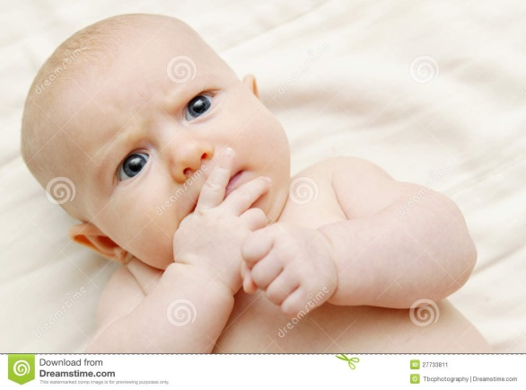
Answer Active or Passive
5. The car was hit by the truck.

Slide 11
The answer is….
Passive

Slide 12
Answer Active or Passive
6. Directions will be given by the teacher.

Slide 13
The answer is….
Passive

Slide 14
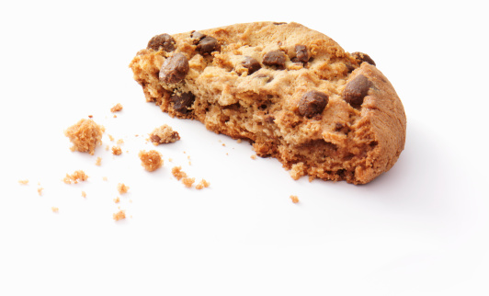
Answer Active or Passive
7. Who ate the last cookie?

Slide 15
The answer is….
Active

Slide 16
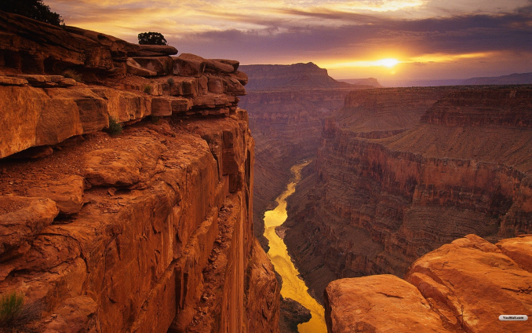
Answer Active or Passive
8. The Grand Canyon is visited by many people each year.

Slide 17
The answer is….
Passive

Slide 18
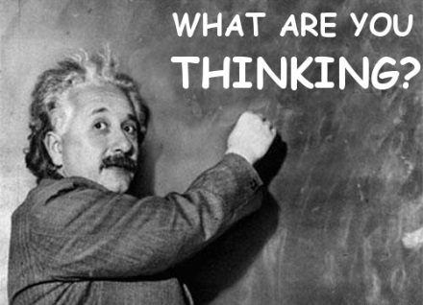
Answer Active or Passive
9. The picture was posted by Tom.

Slide 19
The answer is….
Passive

Slide 20
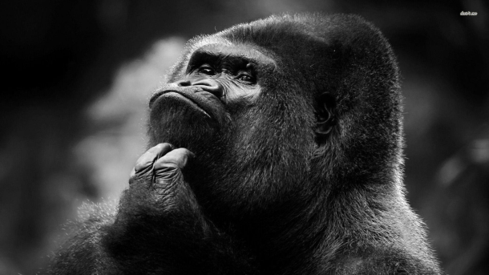
Answer Active or Passive
10. Tessa donated money to a homeless shelter.

Slide 21
The Answer is….
Active

Slide 22
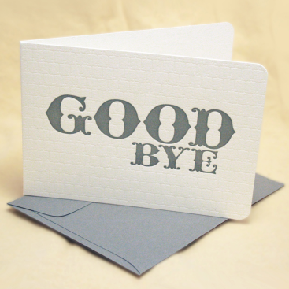
The end………

