Slide 1
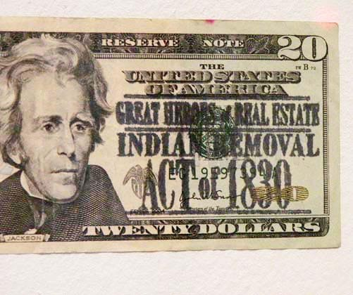
Georgia’s Growth and Expansion
Including the Forced Removal of the Creek and Cherokee Indians

Slide 2
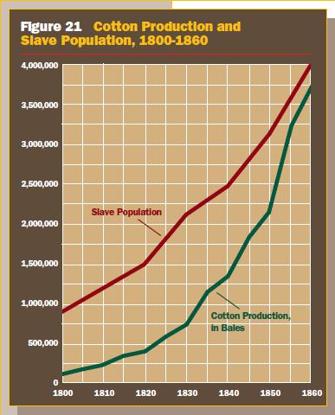
What is the correlation between cotton production and the growth of slavery?
They are both steadily increasing.

Slide 3
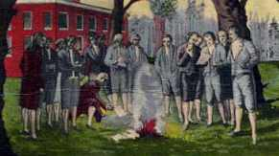
What scandal took place when Georgia’s governor and some legislators were bribed to sell public land to private developers at below-market prices? The Yazoo Land Fraud

Slide 4
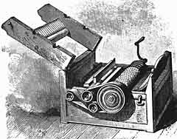
What was the most significant mechanical invention to effect Georgia’s economy in the early 1800s? Cotton Gin

Slide 5
At which state capital were all records of the Yazoo Act ceremoniously burned? Louisville

Slide 6
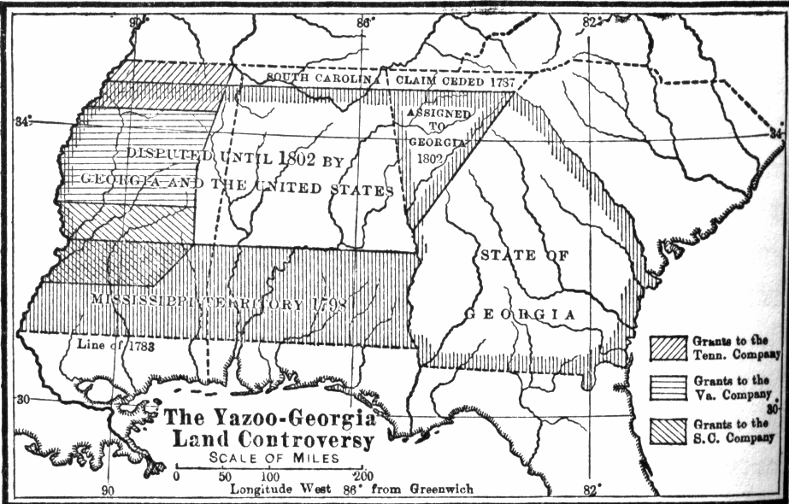
What was the most lasting, negative result of the Yazoo land fraud in Georgia? Georgia had to give up all lands in the Yazoo territory and it s western border changed to the Chattahoochee river.

Slide 7
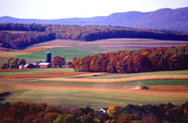
What was the purpose of the headright system in Georgia? It gave each man that was the head of the family up to 1000 acres of land to the east of the oconee river

Slide 8
Why did Georgia give up land claims in what is now Mississippi and Alabama? Because of the Yazoo Land Fraud

Slide 9
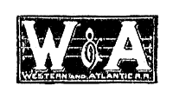
In the mid-1800s, what was Georgia’s main railroad company. 1836- Western and Atlantic railroad

Slide 10
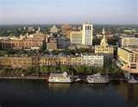
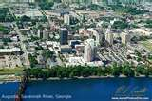
What two Georgia cities served as the state’s capital in the late 1700s? Augusta and Louisville

Slide 11
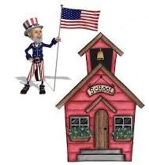
Which statement best describes a “land grant university”? It is where the federal government donates land. In this case it donated land to the University of Georgia-1785

Slide 12
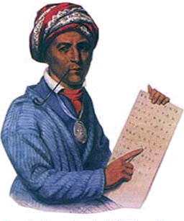
What was George Gist’s (Sequoyah) major contribution to Cherokee culture? He created a syllabary for the Cherokee. This made the Cherokee the first to have a witten language.

Slide 13
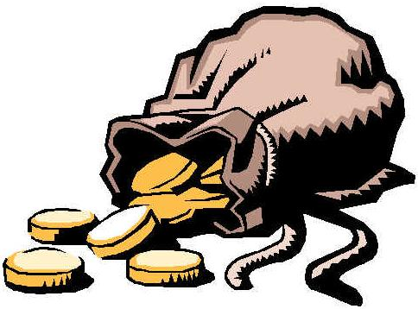
What discovery on Cherokee land led to their final removal from Georgia? The discovery of gold in Dahlonega led to the removal of the Cherokee.

Slide 14
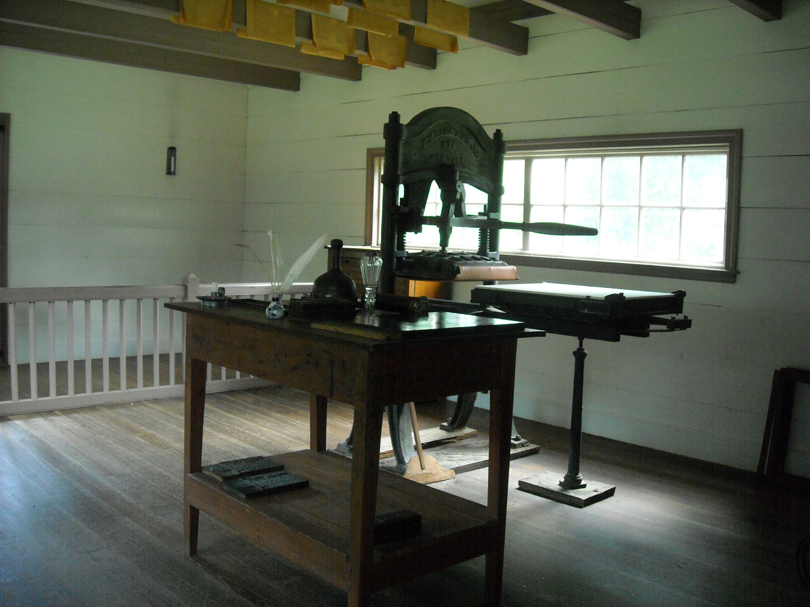
What was the name of the first Native American newspaper? The first native American newspaper was called the Cherokee Phoenix, and it was published in both Cherokee and English.

Slide 15
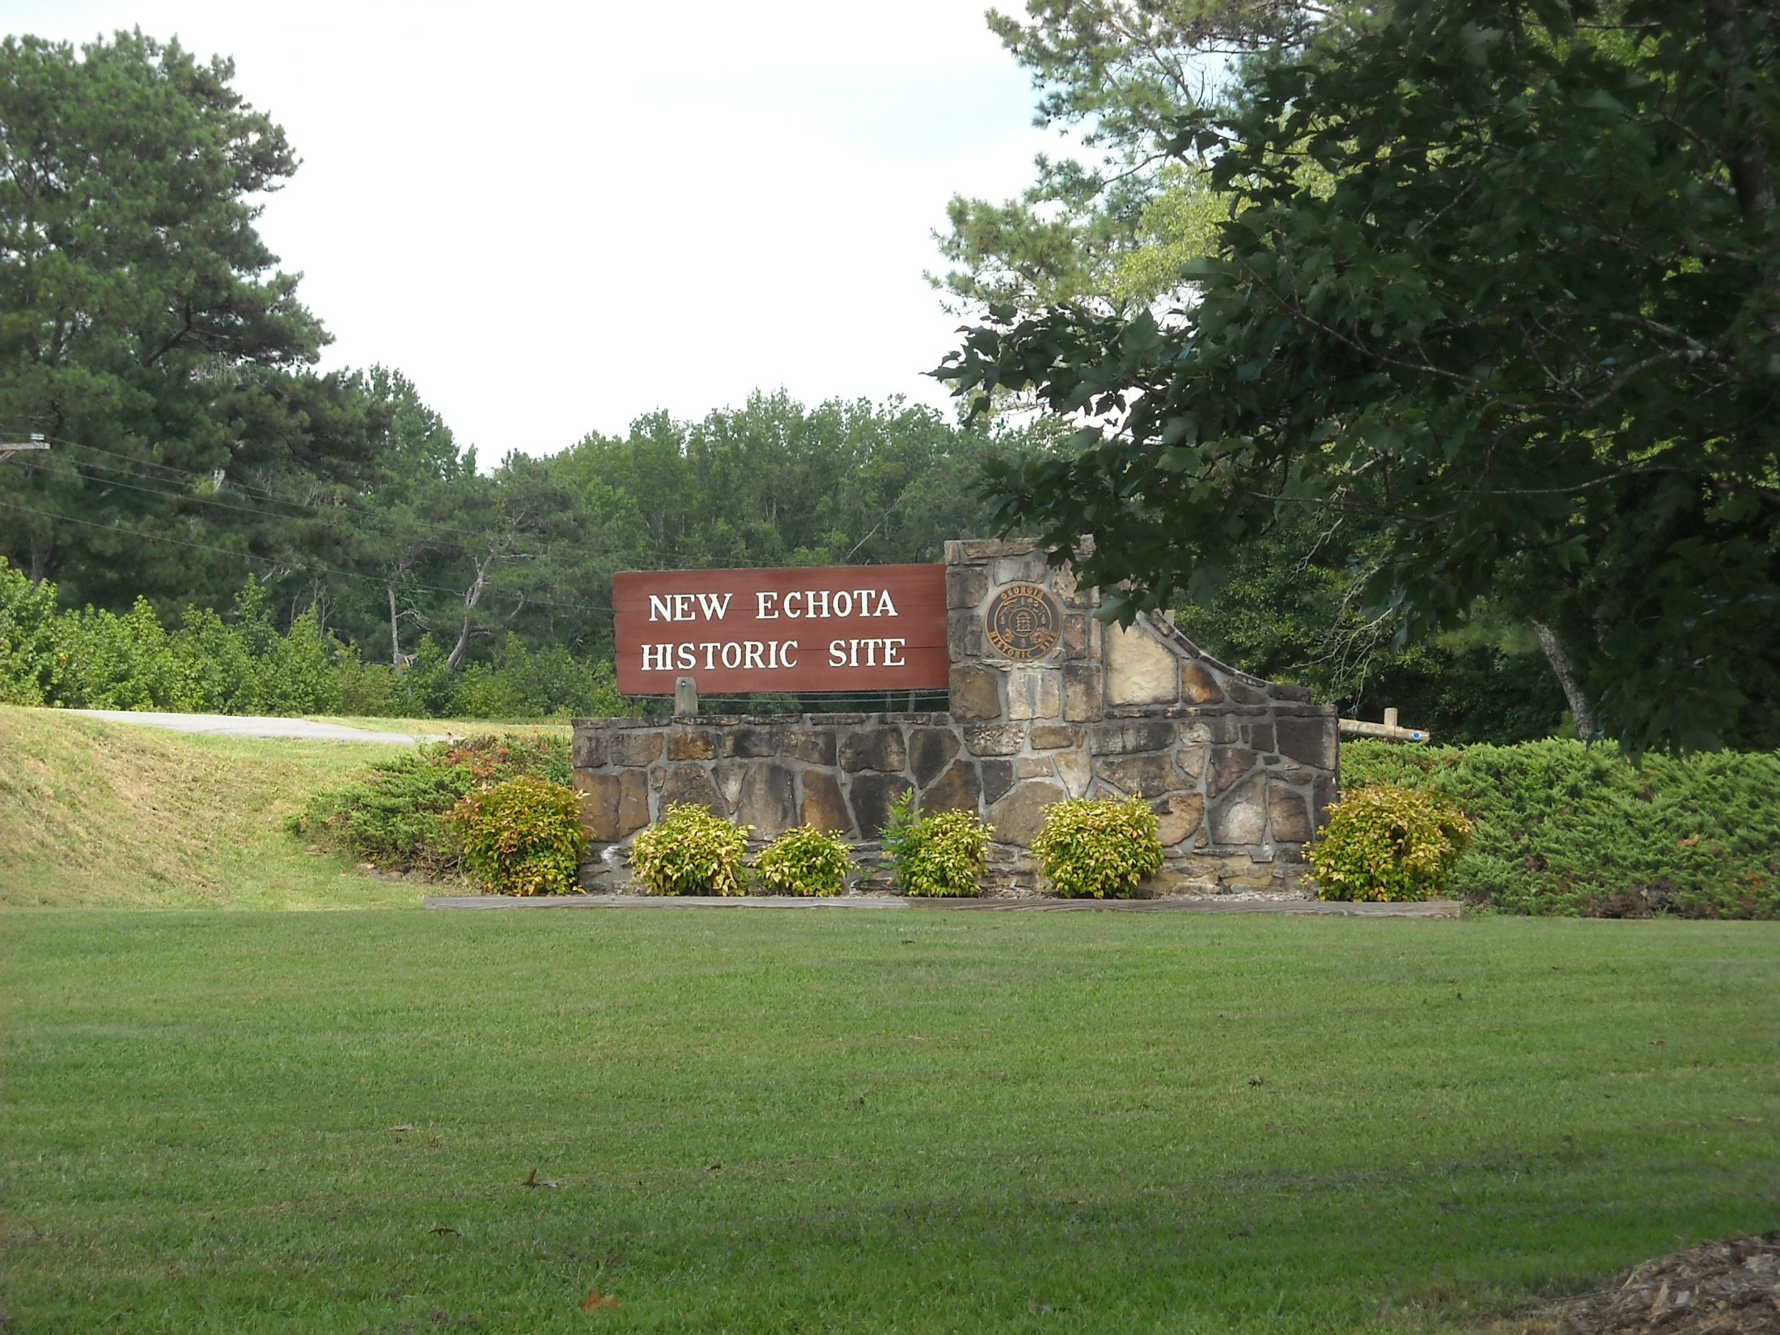
Where was the permanent Cherokee capital located? The permanent capital was called New Echota

Slide 16
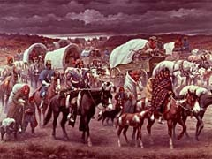
What name was given to the forced removal of the Cherokee from Georgia? It was called the Trial of tears

Slide 17
What Congressional legislation allowed Georgia to push the Creek and the Cherokee out of the state and to seize their lands? The Indian Removal act of 1830

Slide 18
In 1830 what requirement did the Georgia legislature set on whites who lived on Cherokee lands? That they had to say an oath of allegiance to the governor

Slide 19
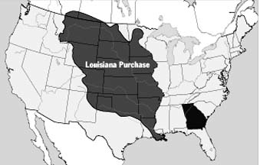
According to the map, what was the western boundary of the Louisiana Purchase? The Rocky Mt.

Slide 20
According to the map, what was the eastern boundary of the Louisiana Purchase? Mississippi river

Slide 21
What did Chief Justice John Marshall and the U.S. Supreme Court decide in Worcester v. Georgia? He said that the Georgia laws do not apply to the Cherokee

Slide 22
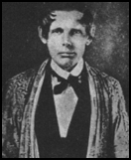
What was the U.S. Supreme Court case Worcester v. Georgia about? Missionaries that lived in the Cherokee territories refused to sign the oath. These missionaries helped fight for the wrights of the Cherokee. They were sent to jail and then the case was taken to the supreme court.

Slide 23
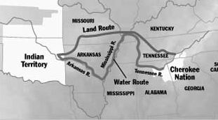
According to the map, in what states was the Cherokee Nation located? Georgia, Alabama, Tennessee, North Carolina

Slide 24
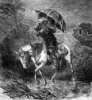
What were ministers called who traveled from town to town preaching on different days in different communities in order to start churches on the frontier? They were called the circuit riders

Slide 25
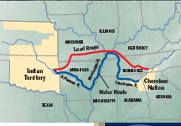
In what state was the Indian Territory where all of the trails which the Indians were taken on end? Oklahoma

Slide 26
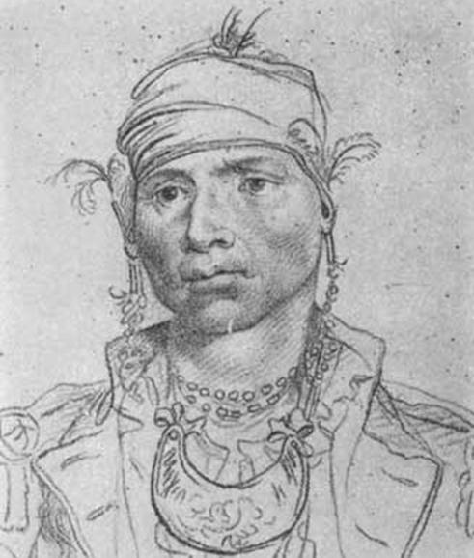
Which Creek chief signed (along with George Washington) the Treaty of New York that gave away Creek lands east if the Oconee River? Alexander Mcgillvray

Slide 27
The University of Georgia is the oldest… land grant university. It is the oldest school of its kind.

Slide 28
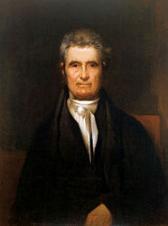
What was the name of the U.S. Supreme Court Chief Justice who wrote the decision in the Worchester v. Georgia case? John Marshall

Slide 29
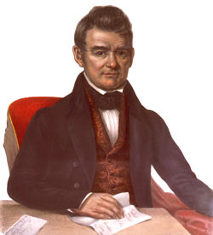
What Cherokee chief petitioned Congress to stop the removal of his people from Georgia? John Ross

Slide 30
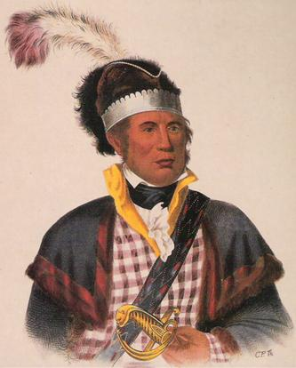
Which Creek chief signed the Treaty of Indian Springs (along with his cousin, GA Gov. George Troup) that gave away the last Creek lands in Georgia and caused him to be executed by his people? William Mcintosh

Slide 31
Why did the Georgia settlers want the lands of the Creek? Since the Proclamation of 1763 wasn’t in place anymore, Georgians wanted to settle west, but that was where the creek were. This led to the Oconee war

Slide 32
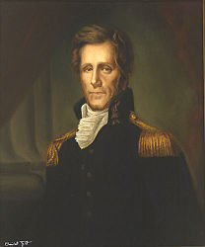
Which president is quoted as responding to the Worchester v. Georgia case with, “John Marshall has rendered his decision. Let him enforce it.” Andrew Jackson

Slide 33
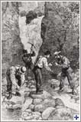
Near what present day city was gold discovered on Cherokee land and sealed the doom of the Cherokee? Dahlonega

Slide 34
What development shifted transportation from shipping cargo and people on riverboats, ferries, and wagons to direct routes across land? The development of railroads

Slide 35
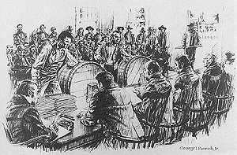
What replaced the headright system as means of distributing public land in Georgia? The land lotteries

Slide 36
What were GA’s first 4 capitals in chronological order? Savannah Augusta Louisville Milledgeville Atlanta

Slide 37
What impact did the cotton gin have on slavery? Slavery increased

Slide 38
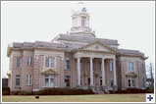
What is the name of Georgia’s first “planned” state capital? Savannah

Slide 39
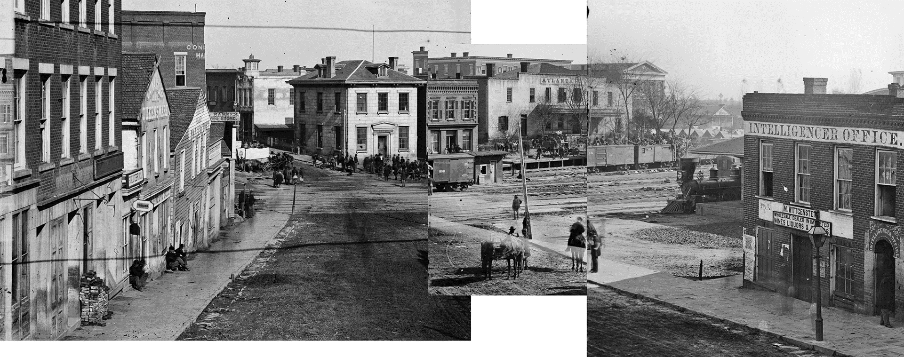
What were the original names for Atlanta? 1. Terminus 2) Marthasville

